Slide 1

Micro Credit Loan Use Case
13-05-2022
Internship-24
Presented by: Ram kumar

Slide 2
Acknowledgement
Data Science with ML
SME -Khushboo Garg
Flip Robo Technology

Slide 3
What is Micro Credit Loan Use Case?
A Microfinance Institution (MFI) is an organization that offers financial services to low income populations. MFS becomes very useful when targeting especially the unbanked poor families living in remote areas with not much sources of income.
the MFI industry is primarily focusing on low income families and are very useful in such areas, the implementation of MFS has been uneven with both significant challenges and successes.
They understand the importance of communication and how it affects a person’s life, thus, focusing on providing their services and products to low income families and poor customers that can help them in the need of hour.
The sample data is provided to us from our client database. It is hereby given to you for this exercise. In order to improve the selection of customers for the credit, the client wants some predictions that could help them in further investment and improvement in selection of customers

Slide 4
Visualization of Micro Credit Loan Use Case

Slide 5
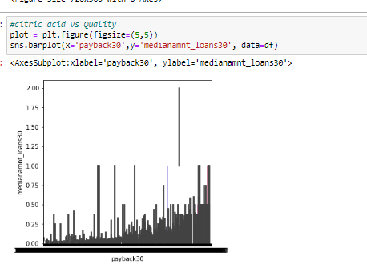
Graphs:

Slide 6
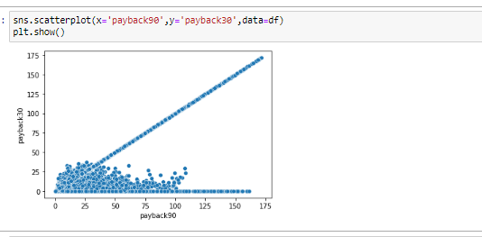
Graphs:

Slide 7
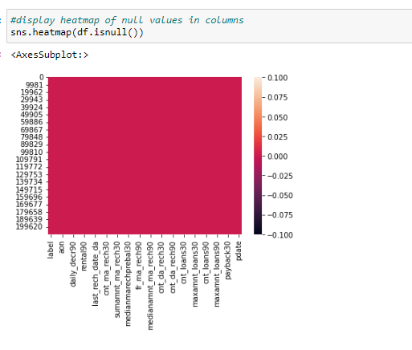
Display null values of columns using heatmap:

Slide 8
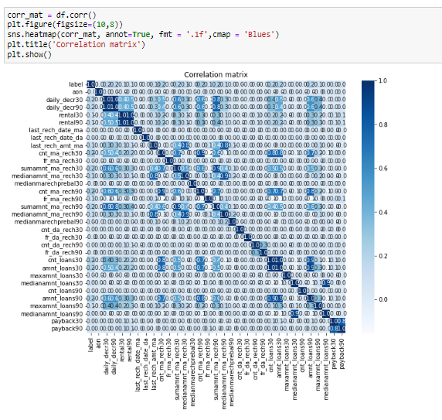
Display correlation of columns using heatmap:

Slide 9
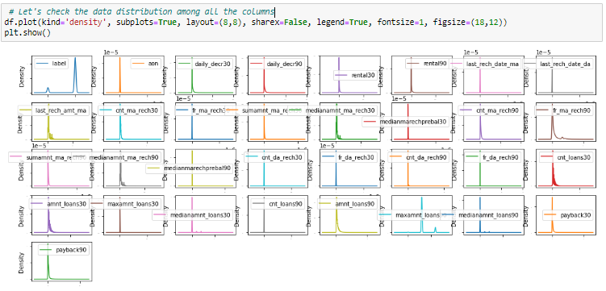
Check the data distribution among all the columns:

Slide 10
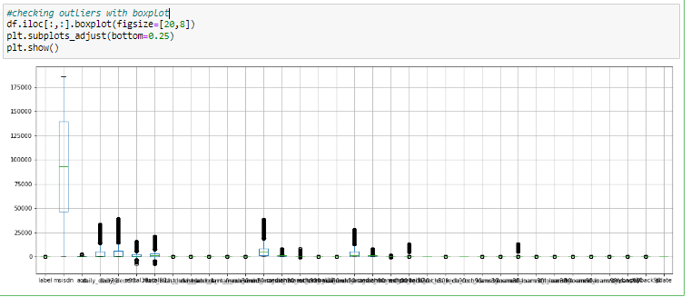
Checking outliers with boxplot:

Slide 11
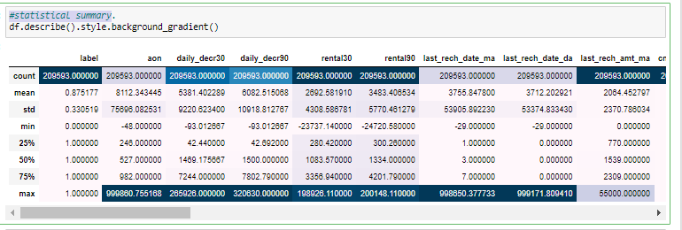
Display statistical summary:

Slide 12
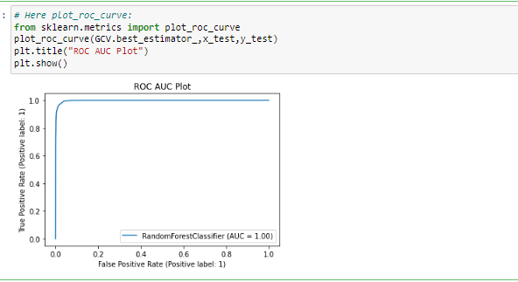
Plot_roc_curve :

Slide 13
Conclusion :
The Random Forest approach is appropriate for classification and regression tasks on datasets with many entries and features that are likely to have missing values when we need a highly accurate result while avoiding overfitting.
the random forest provides relative feature significance, enabling you to select the most important features. It is more interpretable than neural network models but less interpretable than decision trees.
Predicting Loan Default is highly dependent on the demographics of the people, people with lower income are more likely to default on loans.

